Slide 1
Bookstore desktop application
Submitted By:
Rahul Mittal – 191310132072
Samarth Motka – 191310132076
Krish Nasit – 191310132077
Param Patel – 191310132102
Pratham patel – 191310132103
Yug Raithatha - 191310132118

Slide 2
Introduction
Online shopping is the process whereby consumers directly buy goods, services etc. from a seller interactively in real-time without an intermediary service over the internet.
Shoppers can visit web stores from the comfort of their homes and shop as they sit in front of the computer. Consumers buy a variety of items from online stores.
Many people choose to conduct shopping online because of the convenience.

Slide 3
Objective
Design such an application using which one can say 'goodbye' to the days when you stood in line waiting, and waiting some more for a store clerk to finally check out your items.
My main aim is to design such a book store where customer can visit our site anytime of the day from anywhere to view the available books, choose any of them and can order by paying online or can opt for cash on delivery as well.
The administrator will regularly add any new books available to them for sale.
The administrator will take books from the reputed publishers and vendors only.

Slide 4
purpose
Online Shopping system would have the following goals.
Provide a web user interface to add, view, delete records in different areas.
Provide a user interface to enter computer details.
Provide a user interface to change details of all the computers and accessories.
Provide a user interface for users to explore the store and choose items to buy.

Slide 5
Scope
The main scope and deliverables of the project would be to:
Understand and prepare detailed requirement and specifications
Prepare high level and detailed design specifications of the system
Prepare Test Plan and Test cases
Develop the system and coding
Perform unit testing, integration and system testing
Demonstrate a bug free application after suitable modification if needed.

Slide 6

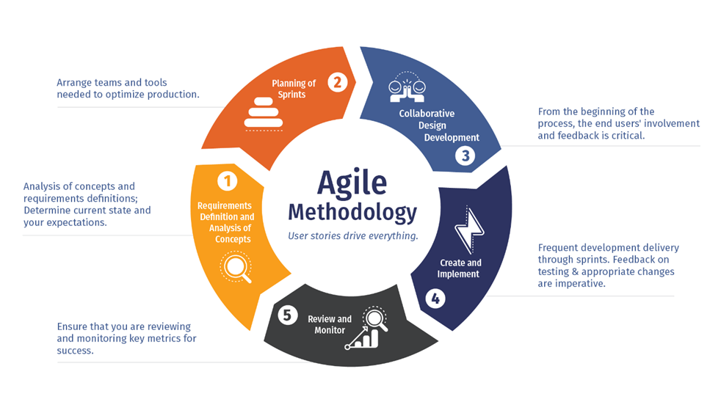
SDlc model
Agile model:
Agile is extremely adaptive which makes it different from all other SDLC. Other SDLCs are predictive and are dependent on proper planning, requirements, and analysis which makes implementations of changes difficult in them.

Slide 7

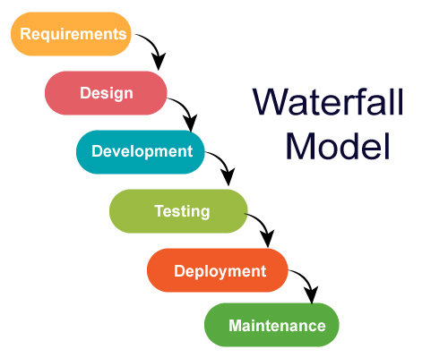
Waterfall model
Due to following reasons:
This model is chosen because our requirements are very well known, clear and fixed. Product definition is stable.
There are no ambiguous requirements in our project.

Slide 8
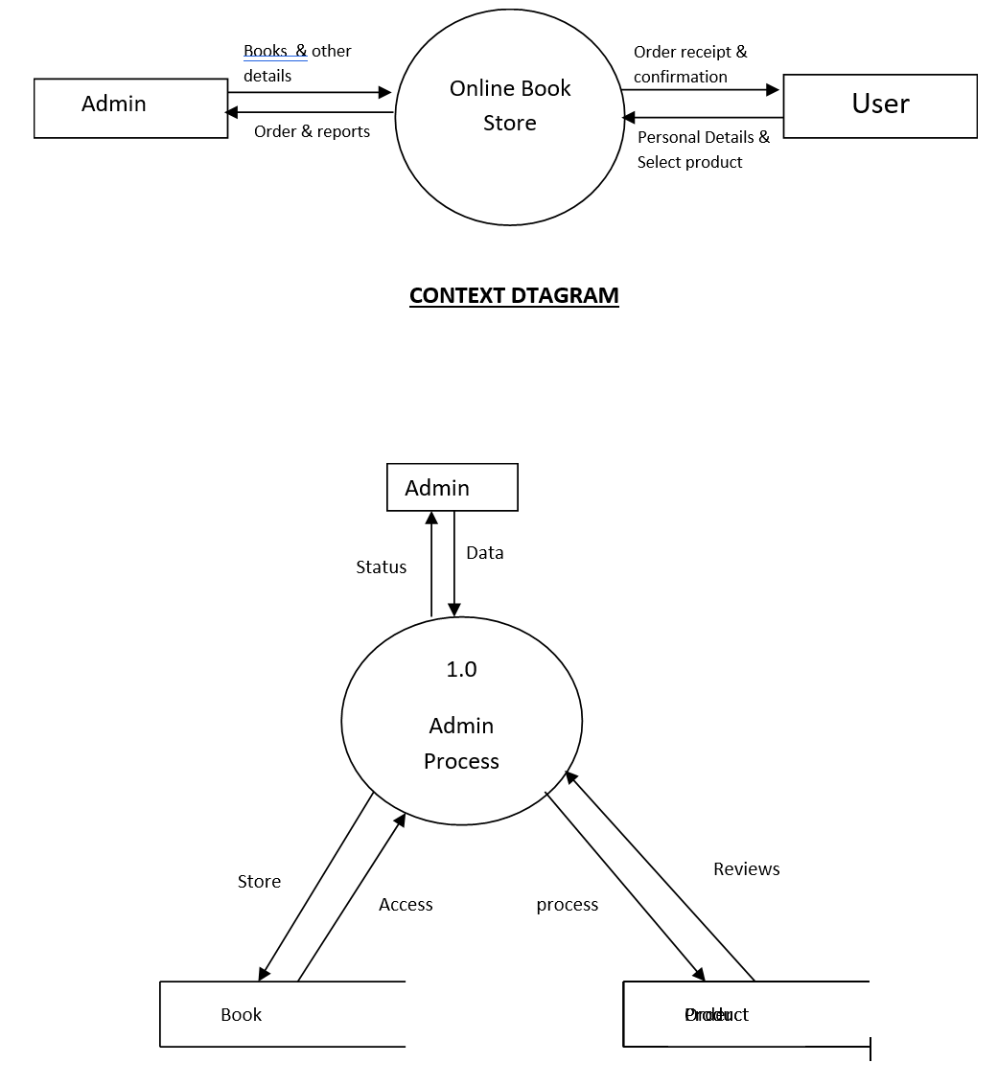
Data flow diagrams level 0 dfd model

Slide 9
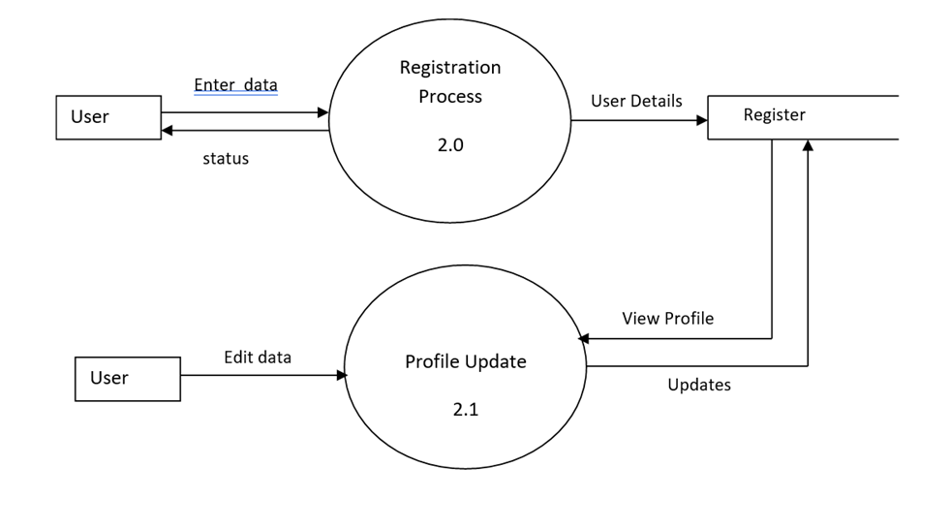
DFD for admin process

Slide 10
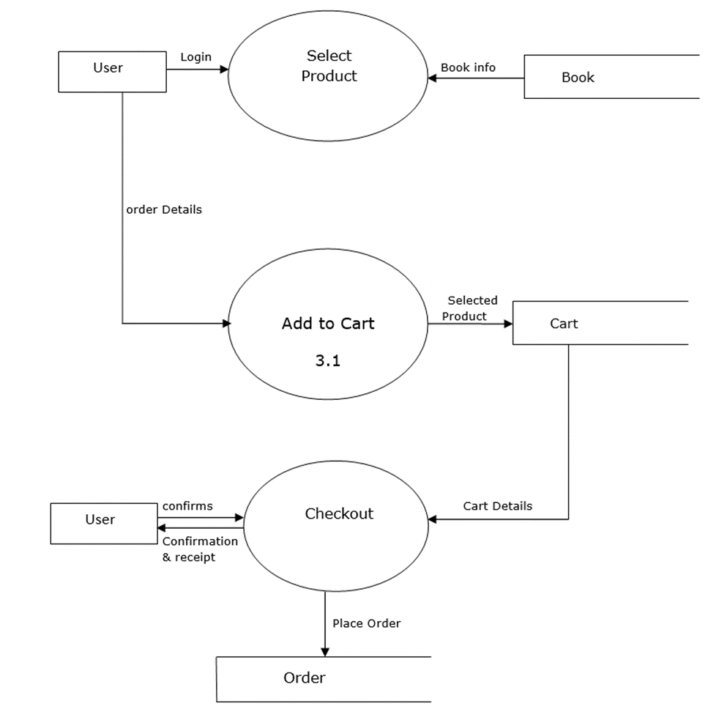
DFD for user registration and profile update

Slide 11
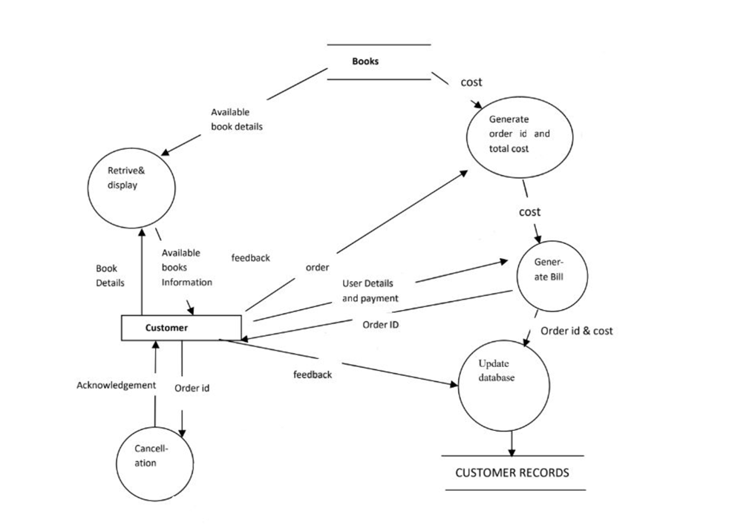
Level 1 DFD Model:

Slide 12
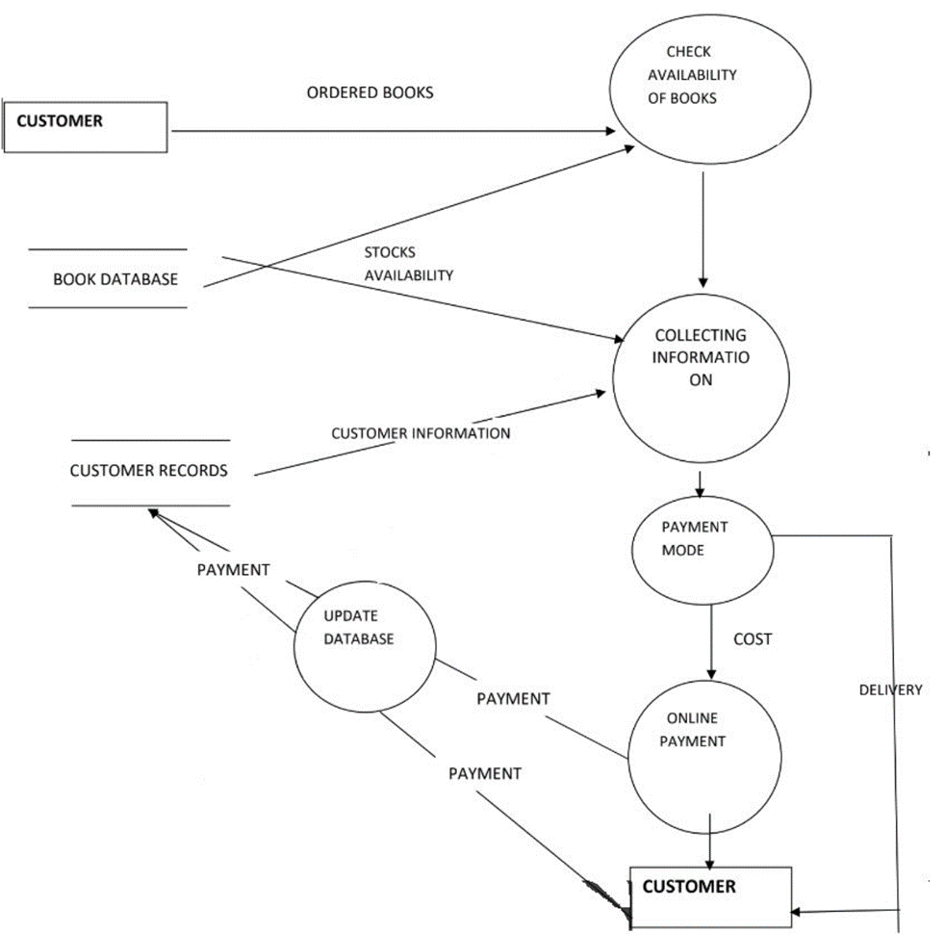
Level 2 DFD Model:

Slide 13
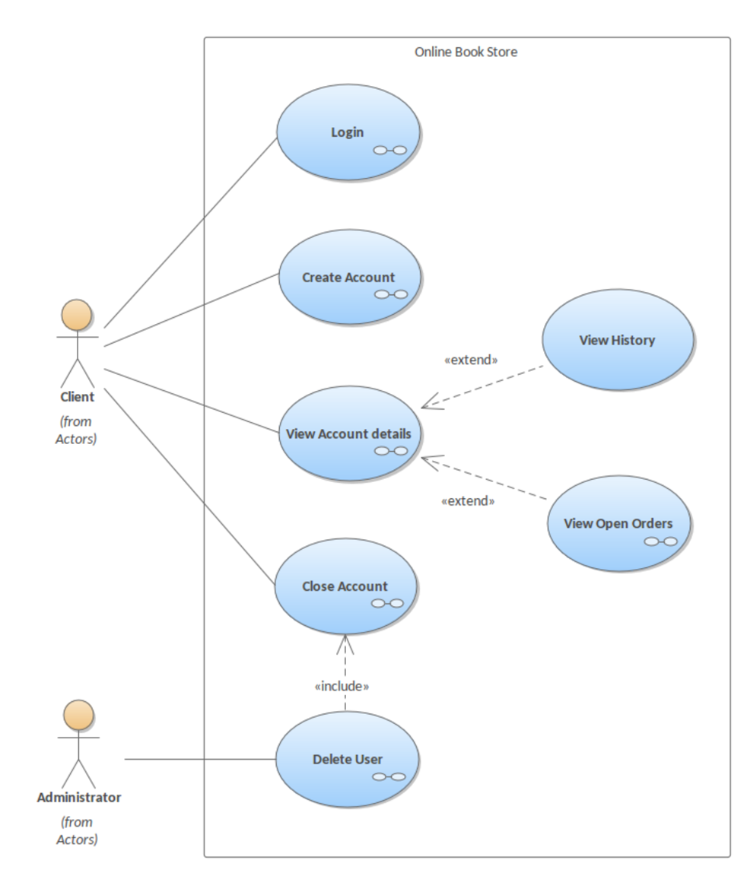
Use case diagrams

Slide 14
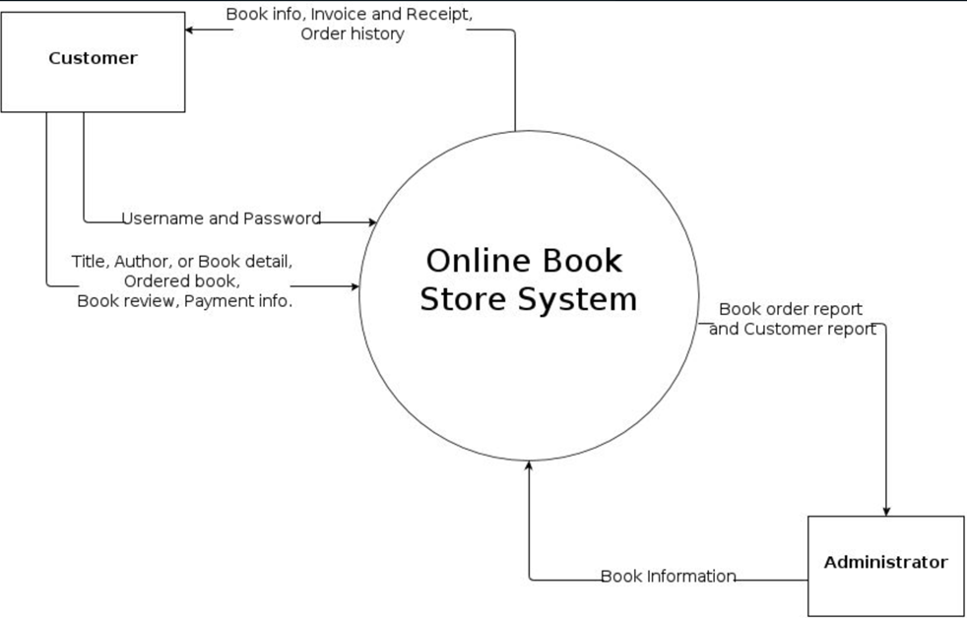
Context diagram

Slide 15
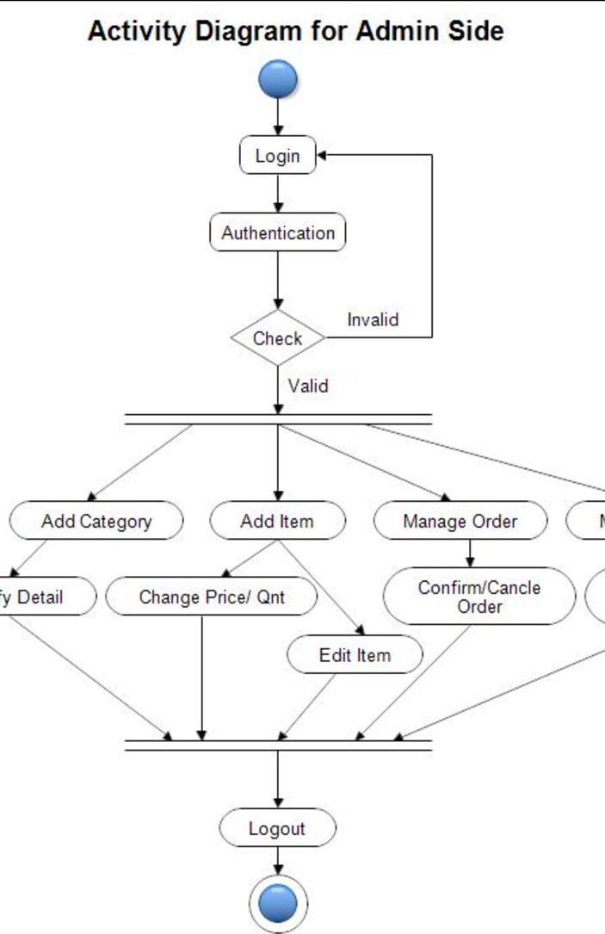
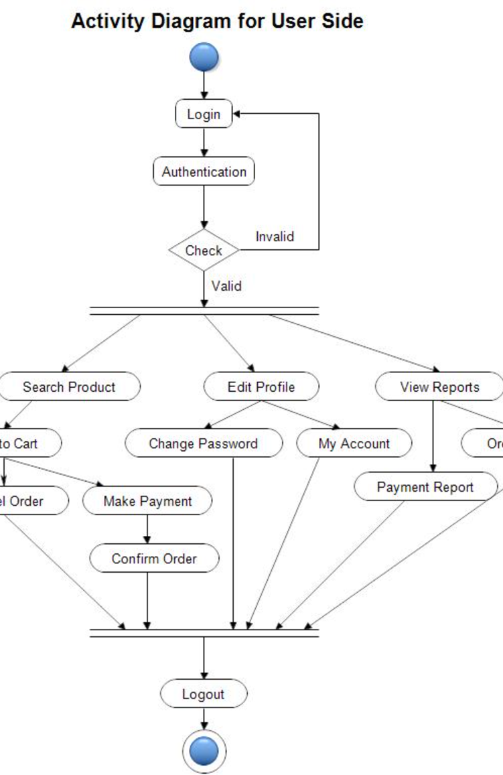
Activity diagram

Slide 16
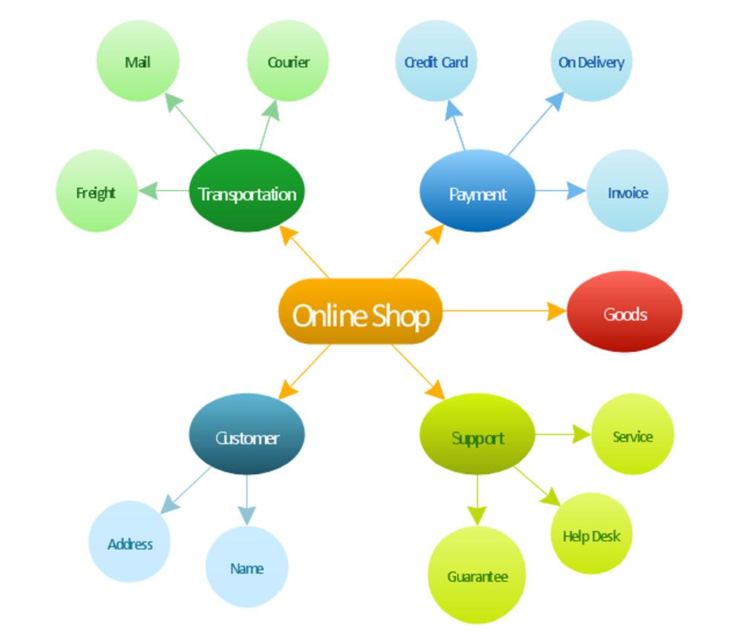
Mind map

Slide 17
features
Functional Requirements
The system must provide following functionality:
Order
Cancellation
Search
Performance and requirement
Non-Functional Requirements
External Interface Requirements

Slide 18
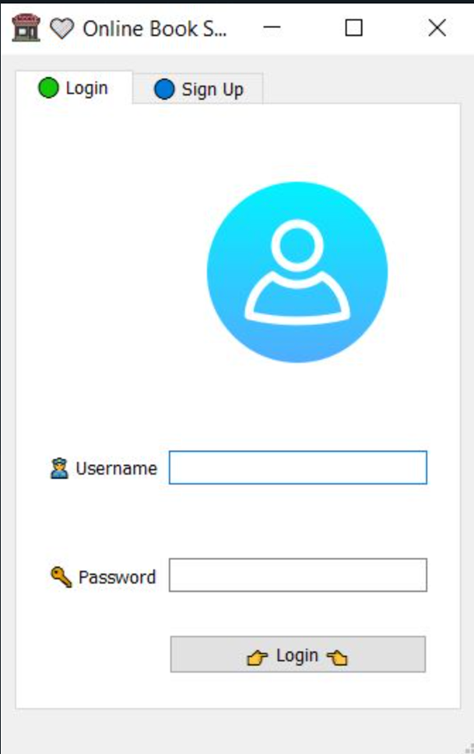
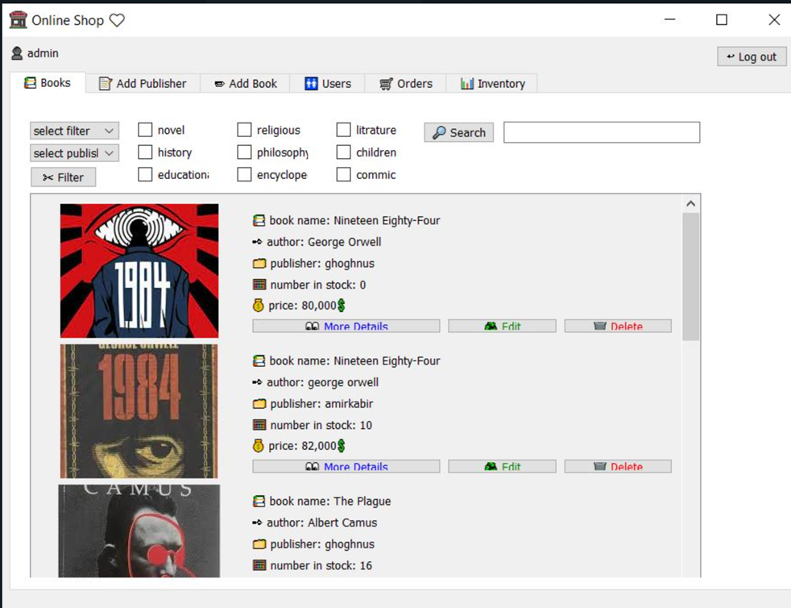
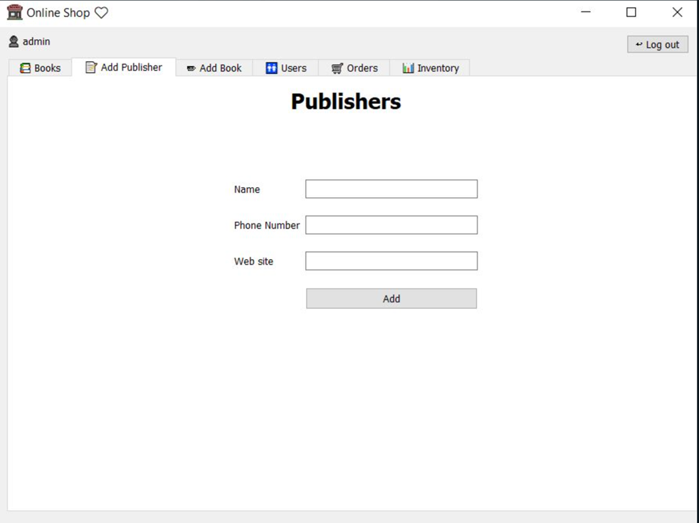
Screenshots

Slide 19
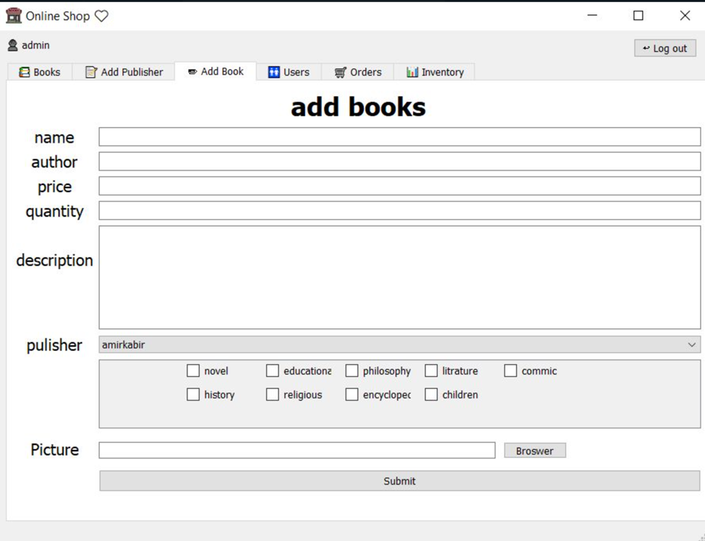
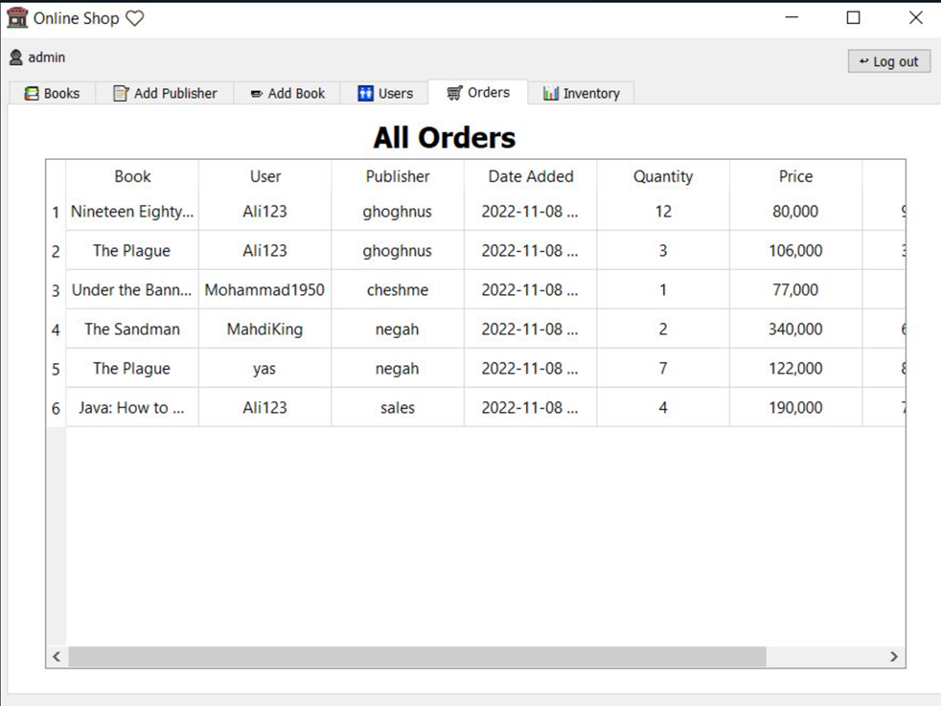
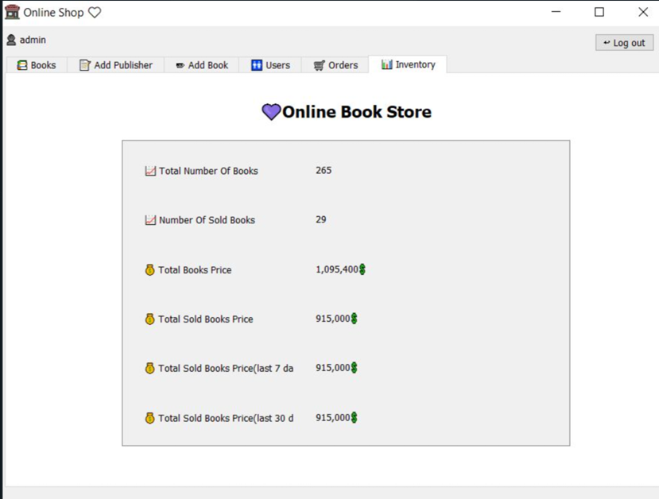

Slide 20
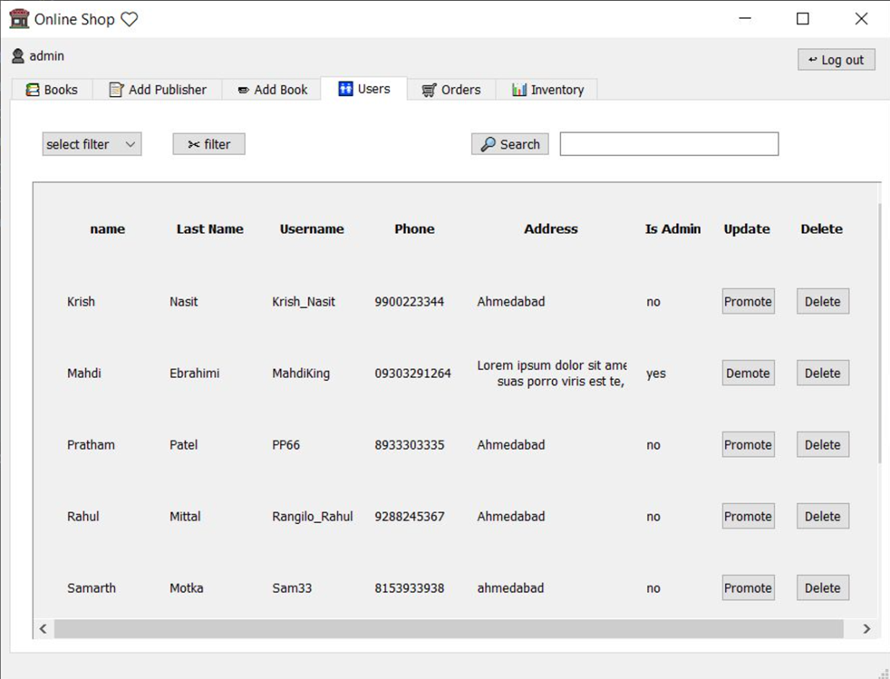
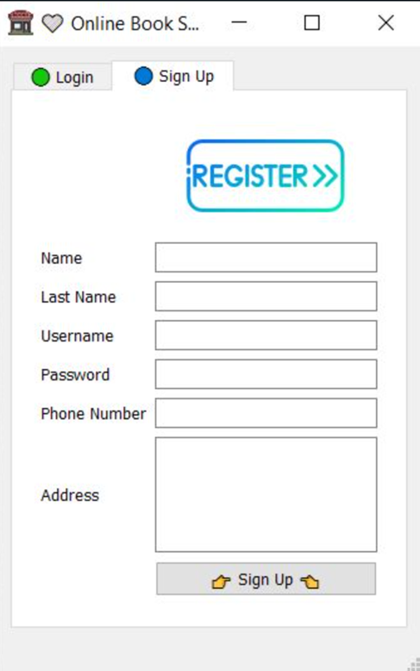
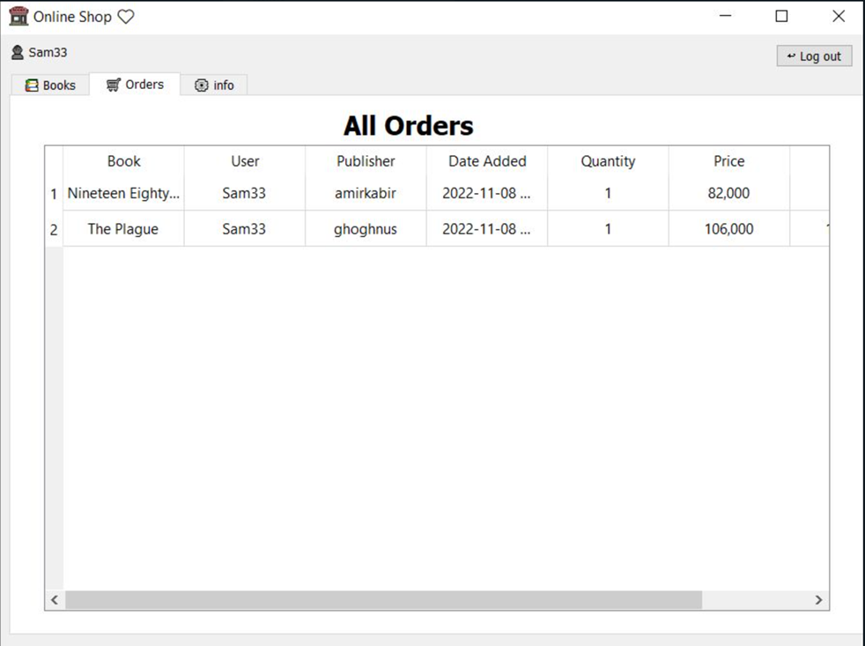
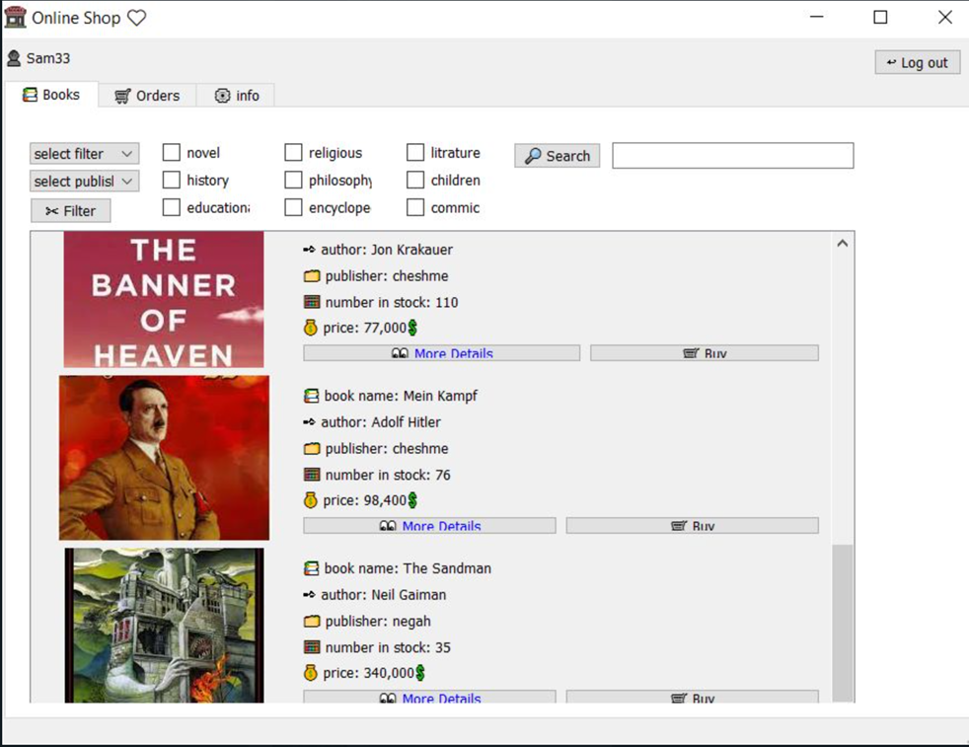

Slide 21
THAnk you

